Slide 1

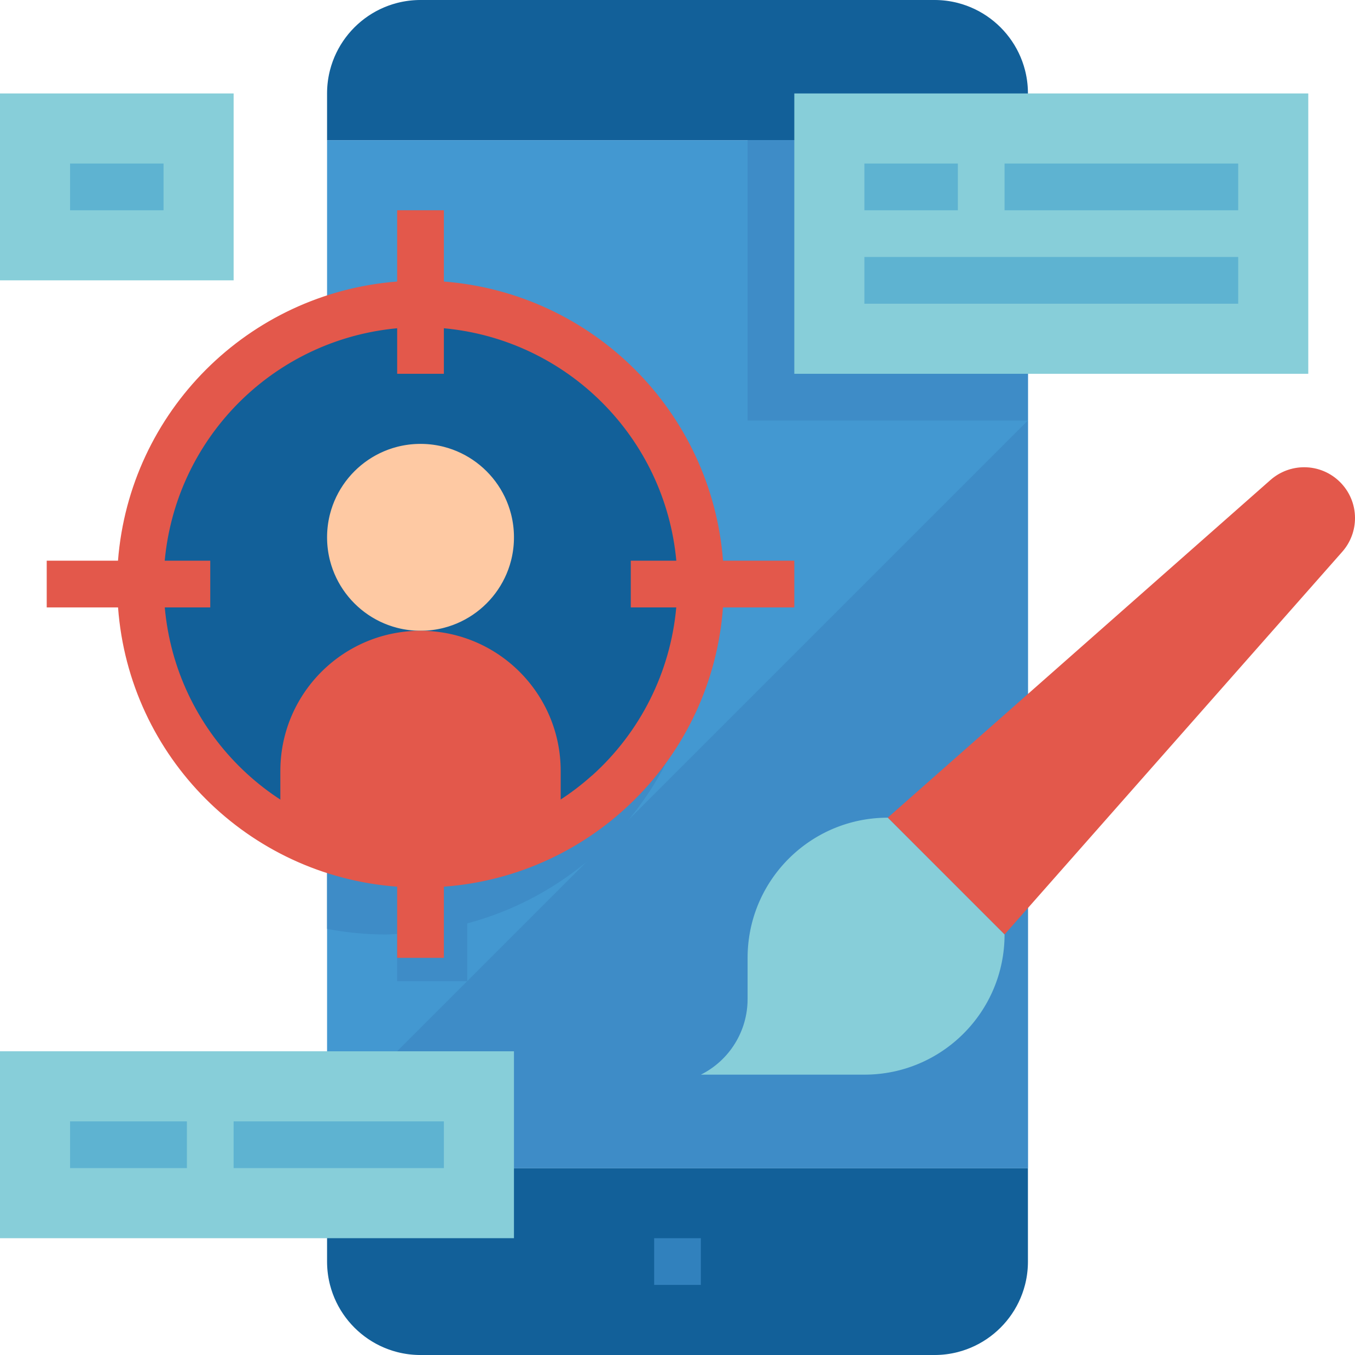
The value of privacy
Quintin Balsdon
Notes:
WhatsApp has recently caused quite a stir In the media when they announced an update to their terms and conditions. While the update itself is nothing to worry about, it did spark an interest in me to do some digging into exactly what privacy is, and why everyone should be concerned about it.

Slide 2

Notes:
Before we go down this rabbit hole, I would like to take a moment to tell you:
- The idea is not to cause panic, but to inform
We are responsible for our own privacy and the companies that I mention are not out to get us, they are out to make a profit
I believe that society and end users have caused a lot of the problem that exists today regarding privacy
In general, people want digital services for free, but they cost money to produce.
We complain about fake news, but so few pay for quality journalism

Slide 3




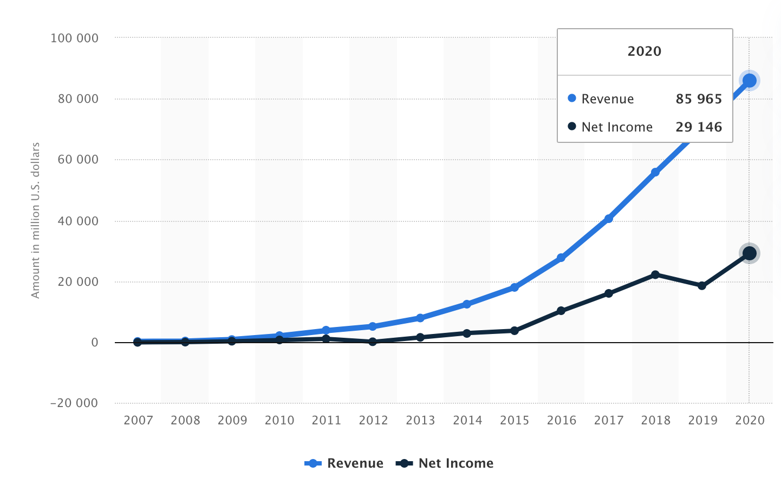
Notes:
Some common misconceptions about privacy
“You have zero privacy anyway, get over it” - Scott McNealy, CEO Sun Microsystems 1999 – while he was deeply criticised at the time, it’s a sentiment a lot of people echo when they make claims like “well, you’re on Facebook” or “you have a tracker in your pocket”
“I’m not interesting enough”
As a person, you are most definitely interesting enough.
If you think your activities are just not enough to warrant consideration from the likes of Google and Facebook, just remember that while on an individual level each of us may not be of enough import to make an impact, the behaviour of large masses of people certainly does. Google turned a single text input into an industry. Just by knowing for what people are searching they have become a giant so large they have to protect themselves from becoming a verb. In January this year, reddit users caused GameStop stock price to skyrocket and imbalance the market. As part of a group, we always have some impact.
Ultimately, private information must have value, otherwise we wouldn’t need passwords on our bank accounts.

Slide 4
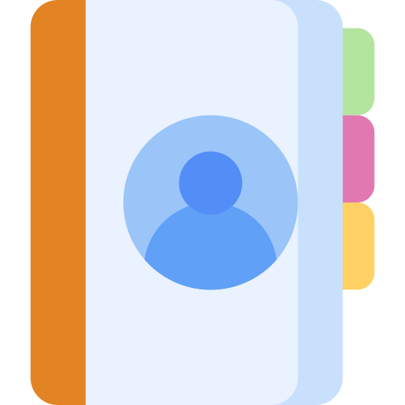
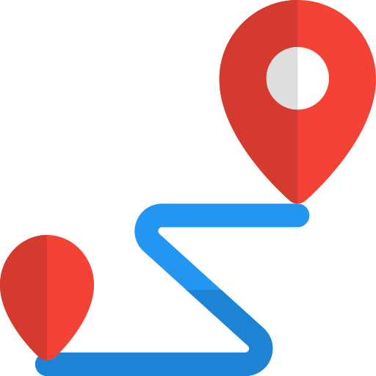
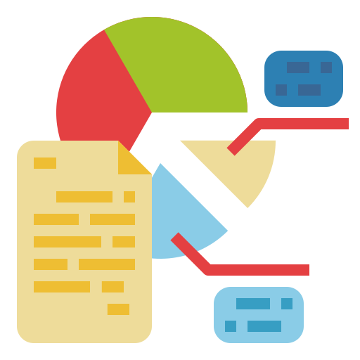

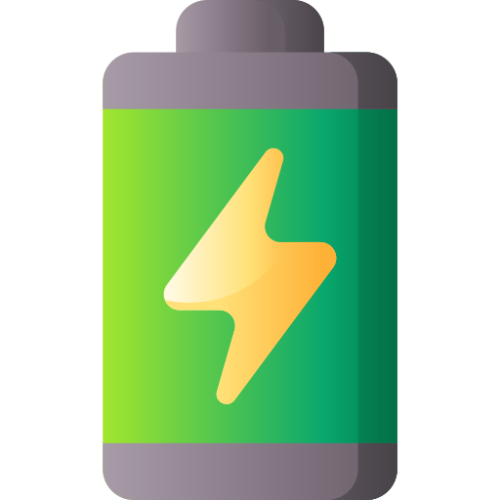
Notes:
[CLICK] What is Privacy?
Cambridge dictionary: “someone's right to keep their personal matters and relationships secret”
It’s a collection of anything that could be used to identify you, or something about you
[CLICK] Contacts
Location
Habits
Battery
I think privacy and security are quite interlinked. The manner in which we share information can be used to uniquely identify us. Think about your bank asking you what your most recent transaction was in order to verify your identity. Some things like proof of address are an absolute joke, as document forgery isn’t exactly new technology.

Slide 5
Notes:
I think if there is one thing we have learned from the pandemic, it’s that our actions have affects on others. The choices we make about our own health can impact the group in unprecedented ways. From wearing masks to second hand smoke, we have an impact on those around us and we should be at least aware of the degree to which we affect peoples lives.
When we like or comment on Facebook, other people have access to the conversation. Facebook is interested in seeing what makes groups of people move. This took a bizarre twist in the pandemic as mental health, fear and confustion started gripping people and more negative conversations started appearing. I realized that I could not have meaningful discourse on the internet a while ago, but it’s so hard realizing I needed to cut certain people out of my life because their ideology was not only in conflict to my own, but to that of public health. I realized I need to cut these people out because I was concerned that the idea may spread through my interactions in those discussions.

Slide 6




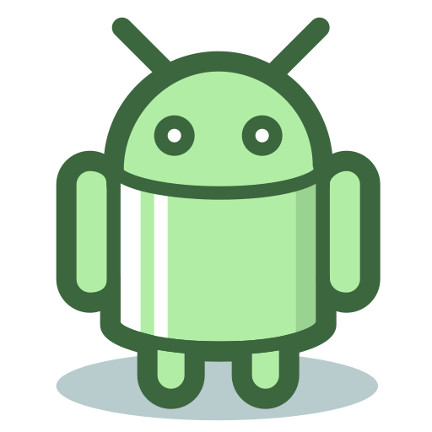

Notes:
While they have valid uses, it has to be said that once a company has access to the data, it should be considered as potentially breached. Sometimes an app needs that type of information, a messaging app without contacts is useless, and one where contacts have to be added manually is useless. But we still need to be able to trust they aren’t monitoring behaviour. And unfortunately – WhatsApp does just that. They track BEHAVIOUR:
“[WhatsApp] collects information about your activity on [their] Services, like service-related, diagnostic, and performance information. This includes information about your activity (including how you use [their] Services, your Services settings, how you interact with others using [their] Services (including when you interact with a business), and the time, frequency, and duration of your activities and interactions), log files, and diagnostic, crash, website, and performance logs and reports. ”
“[Telegram] may share your personal data with: (1) [their] parent company, Telegram Group Inc, located in the British Virgin Islands; and (2) Telegram FZ-LLC, a group member located in Dubai, to help provide, improve and support our Services. [The claim they] will implement appropriate safeguards to protect the security and integrity of that personal data” – They do at least admit why they track certain types of behaviour, for example, so that most frequently contacted contacts appear first in a search list.
Signal’s terms and conditions are little more sparse for my liking – so I started digging in manifest files.
Android apps have a very neat feature known as a manifest file. This file is a record of every screen in an app, as well as any “broadcast receiver” – which we all know as a subscriber in a publish subscribe model. There are three types of broadcast in an Android app
System global
App global
App local
One interesting thing I have found while digging through all these apps was not that they take so much data from the phones, but how much data they collect and share amongst their own community of apps. So many apps have a link to an amazom.com cookie jar, for example.

Slide 7
Notes:
A lot of people are scared of location, Bluetooth, etc being shared. Me? I scared of my battery information. Location and Bluetooth can be turned off, and a lot of privacy work has been done in these areas over the last few years. Android is coming out with new protections regarding location every update, and Bluetooth Low energy stupidly requires location access because a device’s MAC address can be uniquely identified and therefore the device pinpointed, but I’m pretty sure we could achieve the same effect with multiple local wifi hotspots. Anyway, a lot of these privacy “quick wins” are now guarded by user controlled gates – users have to opt in specifically to share that data with a company
Battery is one of the most interesting things I have found to be tracked, not just by apps but websites as well.
In 2017, University of Princeton researchers proved that the “battery status API” for HTML5 demonstrated that by using adverts (sockets) they could track unique users even when they switched to private browsing or using a VPN, but monitoring the state of the battery. The longer a user stays connected, the more likely they are to be tracked.
On a mobile phone battery status has a lot more to say about behavior than simple browsing habits.
Interestingly enough, Telegram and Signal do not track battery, while WhatsApp and FB messenger does.
https://eprint.iacr.org/2015/616.pdf

Slide 8
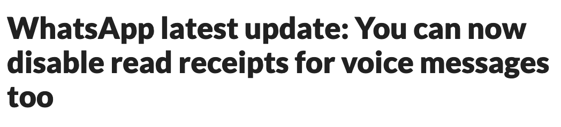
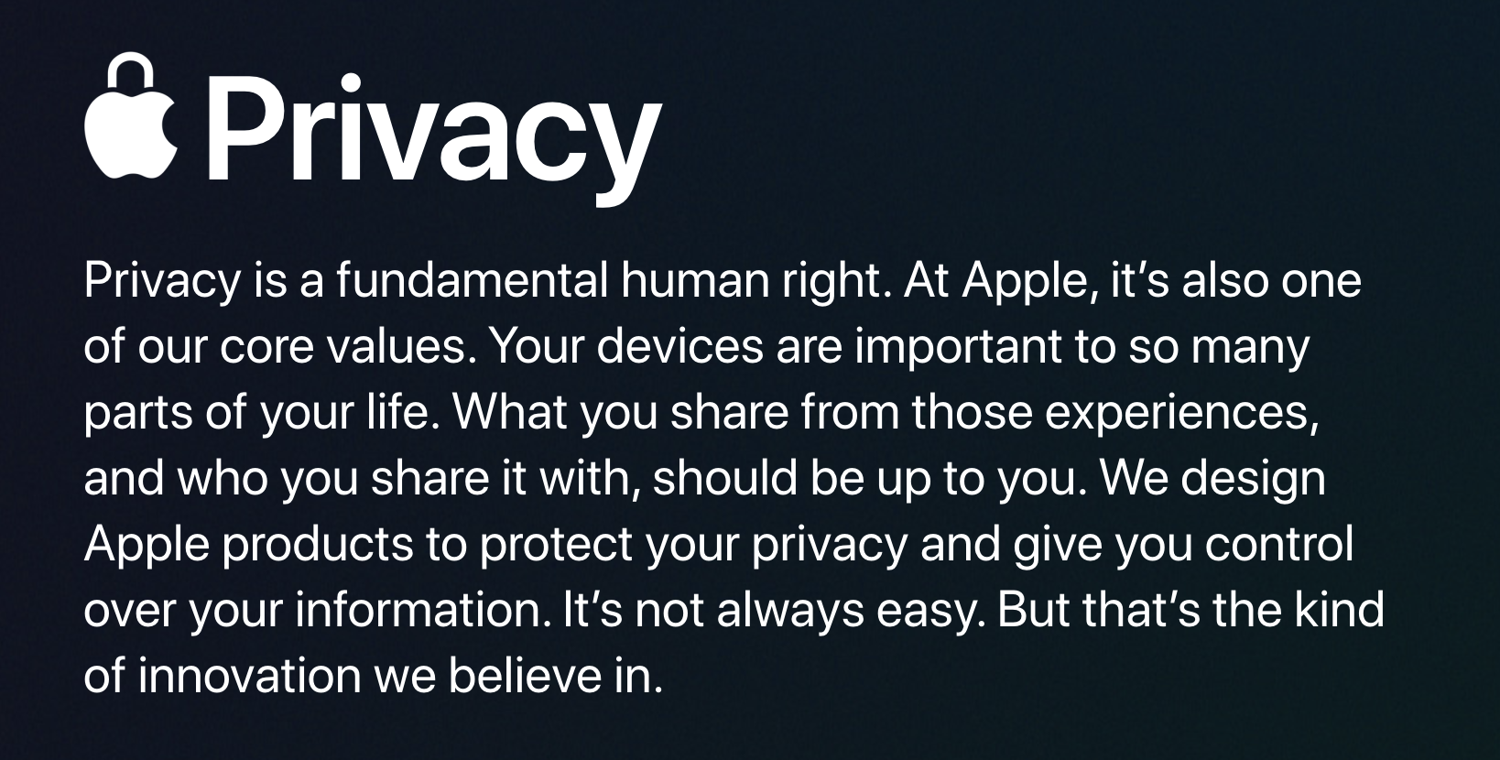
Notes:
It seems that at least on the surface, companies are responding. Every day we’re seeing new policies being put into place regarding giving the user back their sense of privacy.

Slide 9

Privacy is a commodity
Notes:
What are we prepared to trade for our private information and the people who connected to us? The answer to that clickbait quiz?
Friends of mine were talking about deep fakes and how they are used, and then he sent me this as a joke. Now not only does this demonstrate how I could be faked, but it also shows the kind of access my friends have to me. He uploaded my image to some web site and generated this. Anyone can do that now.
The implications of this are quite scary – I have not been able to unlock my iPhone with this, but it does feel like it goes a little bit beyond the dangers of photoshopping.

Slide 10
HERE IS A JOKE TO PLACATE THE sense OF IMPENDING DOOM
Notes:
What are we prepared to trade for our private information and the people who connected to us? The answer to that clickbait quiz?
Friends of mine were talking about deep fakes and how they are used, and then he sent me this as a joke. Now not only does this demonstrate how I could be faked, but it also shows the kind of access my friends have to me. He uploaded my image to some web site and generated this. Anyone can do that now.
The implications of this are quite scary – I have not been able to unlock my iPhone with this, but it does feel like it goes a little bit beyond the dangers of photoshopping.

